Slide 1
Forms & Combining It All

Slide 2
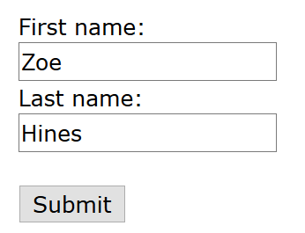
Form Element
A <form> element collects user input
Most interactive content is contained with the <form> element like check boxes, lists and buttons
The user input can then be sent to a server for processing
An example of a simple form

Slide 3
Input Elements
The <input> element is a sub element nested a <form>
This is the most commonly used form element as it have multiple different displays
The <input> element uses the type attribute to control how it will be displayed e.g. checkbox, button, text field…
<input type=“text”>

Slide 4

Input Element
<input type="button">
<input type="checkbox">
<input type="color">
<input type="date">
<input type="email">
<input type="file">
<input type="hidden">
<input type="image">
<input type="month">
<input type="number">
<input type="password">
<input type="radio">
<input type="range">
<input type="reset">
<input type="search">
<input type="submit">
<input type="tel">
<input type="text">
<input type="time">
<input type="url">
<input type="week">

Slide 5
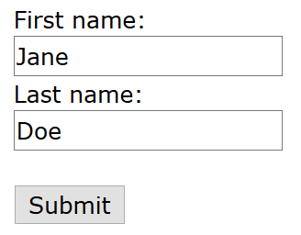
Text Fields
The type="text" attribute value denotes single line text fields
The name attribute is used to reference in JavaScript and other HTML elements
The <label> element creates a text label for a given element on a form
The for attribute within the <label> element ties it to an <input> element using the same name
The type=“password" attribute value creates a masked single line text field
<form> <label for="fname">First name:</label><br> <input type="text" id="fname“ name="fname"><br> <label for="lname">Last name:</label><br> <input type="text" id="lname" name="lname"> </form>

Slide 6
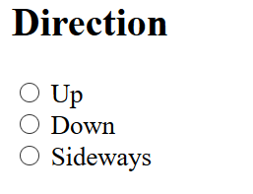
Radio Buttons
The type="radio" sets the input to single selection radio buttons
The name attribute is used to tie a set of radio buttons together as well as labels
The value attribute is the programmatic value attached to the selection
<h2>Direction</h2> <form> <input type="radio" id=“up-option" name=“direction" value=“up"> <label for=“up-option">Up</label><br> <input type="radio" id=“down-option" name="direction" value=“down"> <label for=“down-option">Down</label><br> <input type="radio" id=“side-option" name=“direction" value=“side"> <label for=“side-option">Sideways</label> </form>

Slide 7
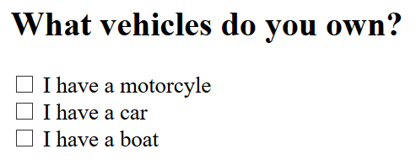
Checkboxes
The type=“checkbox" sets the input to multi selection checkboxes
Nearly the same syntax as a type="radio"
<h2>What vehicles do you own?</h2> <form> <input type="checkbox" id="vehicle1" name="vehicle1" value="Bike"> <label for="vehicle1"> I have a motorcycle</label><br> <input type="checkbox" id="vehicle2" name="vehicle2" value="Car"> <label for="vehicle2"> I have a car</label><br> <input type="checkbox" id="vehicle3" name="vehicle3" value="Boat"> <label for="vehicle3"> I have a boat</label> </form>

Slide 8
List Element
<input list="browsers"> <datalist id="browsers"> <option value="Internet Explorer"> <option value="Firefox"> <option value="Chrome"> <option value="Opera"> <option value="Safari"> </datalist>
The <datalist> element that contains pre-defined options for an <input> element
The list attribute is used to identify a list and ties it to the <datalist> element

Slide 9
Other Form Elements and Attributes

Slide 10
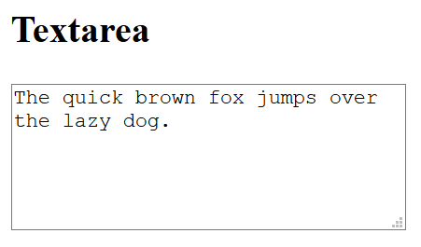
Text Area
The <textarea> element is a multiline text field
The row attribute sets the number of lines in the text box
The cols attribute sets the width of the text box
<textarea name="message" rows="10" cols="30"> The quick brown fox jumps over the lazy dog. </textarea>

Slide 11
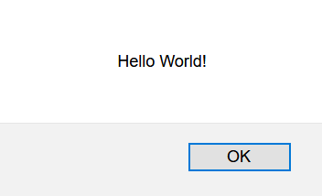
Buttons
<input type="button" onclick="alert('Hello World!')" value="Click Me!">

Slide 12
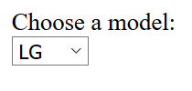
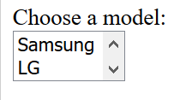
Drop Down Lists
The <select> element defines a standard drop down list
The <option> element defines an option that can be selected.
By default, the first item in the selected.
To pre-selected and option, use the selected attribute
The size attribute determines the number of visible values
<label for=“phone"> Choose a model:</label><br> <select id=“manufactures" name=“phone“ size=“2”> <option value=“samsung">Samsung</option> <option value=“lg“ selected>LG </option> <option value=“motorola">Motorola</option> <option value=“apple">Apple</option> </select>
Normal Dropdown:
Size Based Dropdown:

Slide 13
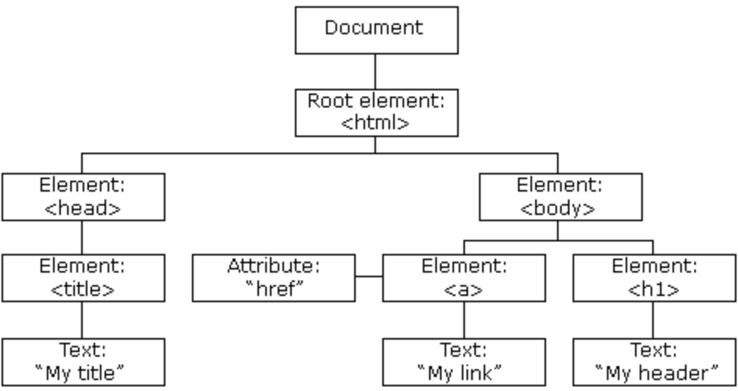
HTML DOM
The HTML DOM which stands for Document Object Method
This can be represented as a tree of objects
This is how JavaScript creates dynamic HTML
JS can change all the HTML elements in the page
JS can change all the HTML attributes in the page
JS can change all the CSS styles in the page

Slide 14

HTML CSS & JavaScript All Together

Slide 15
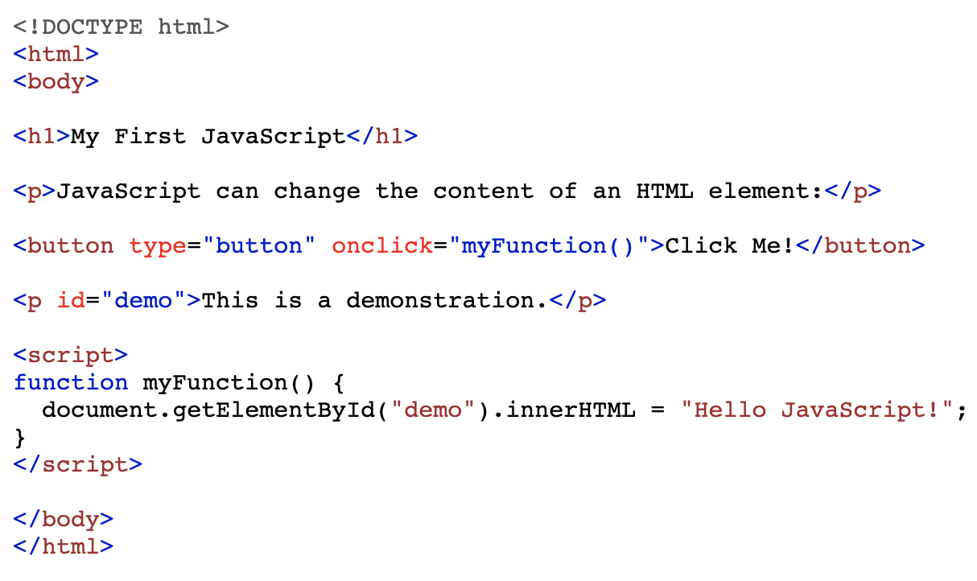
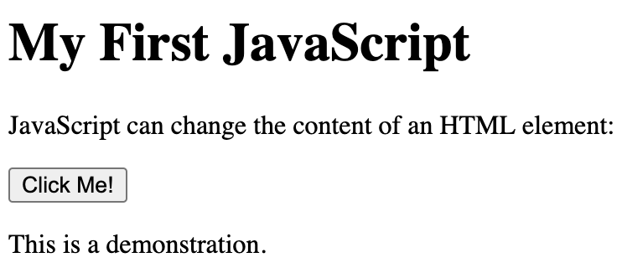

Setting Attributes with JavaScript (By ID)

Slide 16
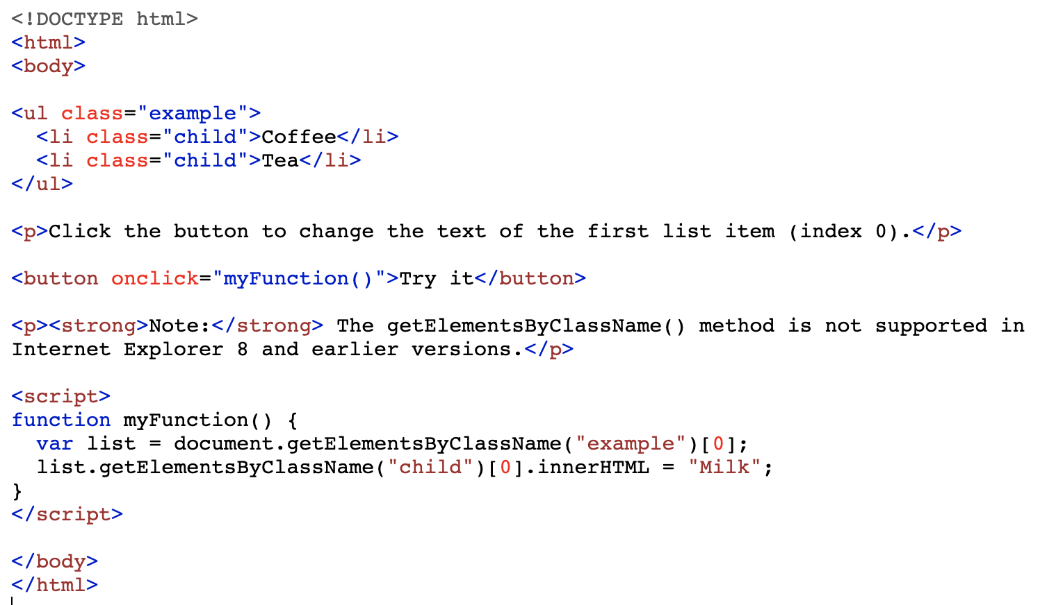
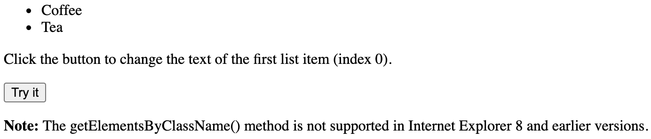
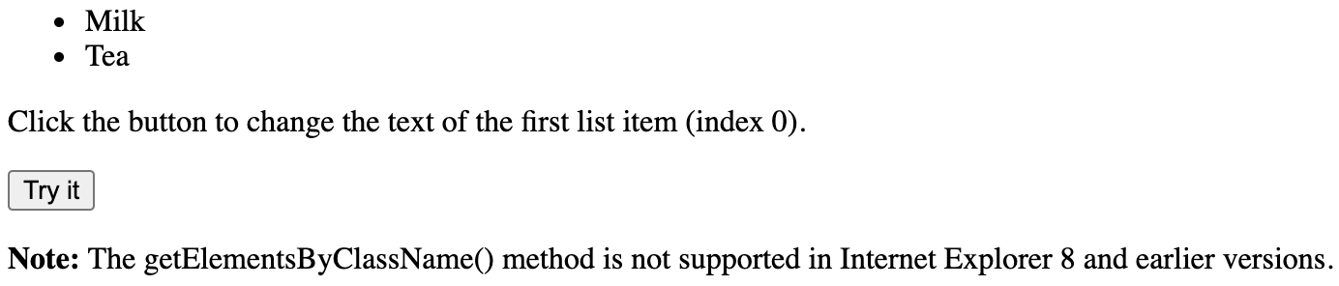
Setting Attributes with JavaScript (By Class)

Slide 17
Create Elements in JavScript
// create a new div element
var newDiv = document.createElement("div");
var newContent = document.createTextNode("Hi there and greetings!");
Method | Description
document.createElement(element) | Create an HTML element
document.createTextNode(text) | Create an HTML text element

Slide 18
Add/Remove elements
// create a new div element
var newDiv = document.createElement("div");
var newContent = document.createTextNode("Hi there and greetings!");
// add the text node to the newly created div
newDiv.appendChild(newContent);
// add the newly created element and its content into the DOM
var currentDiv = document.getElementById("div1");
document.body.insertBefore(newDiv, currentDiv);
document.removechild(document.getElementById(“example"));
Method | Description
document.removeChild(element) | Remove an HTML element
document.appendChild(element) | Add an HTML element
document.replaceChild(new, old) | Replace an HTML element
document.body.insertBefore(before, after) | Insert HTML element Before another

Slide 19
Altering CSS with JavaScript
Property | Description
element.style.property = new style | Change the style of an HTML element
Method | Description
element.setAttribute(attribute, value) | Change the attribute value of an HTML element
<script> document.getElementById("p2").style.color = "blue"; </script>

Slide 20
Submit & Action
<form action="/action_page.php“ target="_blank"> <label for="fname">First name:</label><br> <input type="text" id="fname" name="fname" value="John"><br> <label for="lname">Last name:</label><br> <input type="text" id="lname" name="lname" value="Doe"><br><br> <input type="submit" value="Submit"> </form>

